Slide 1
VISUALIZATION OF IMDB
Final PROJECT

Slide 2



TOOLS USED

Slide 3
We have extracted through web scraping from the IMDB database and inserted in mongo-db cloud

Slide 4
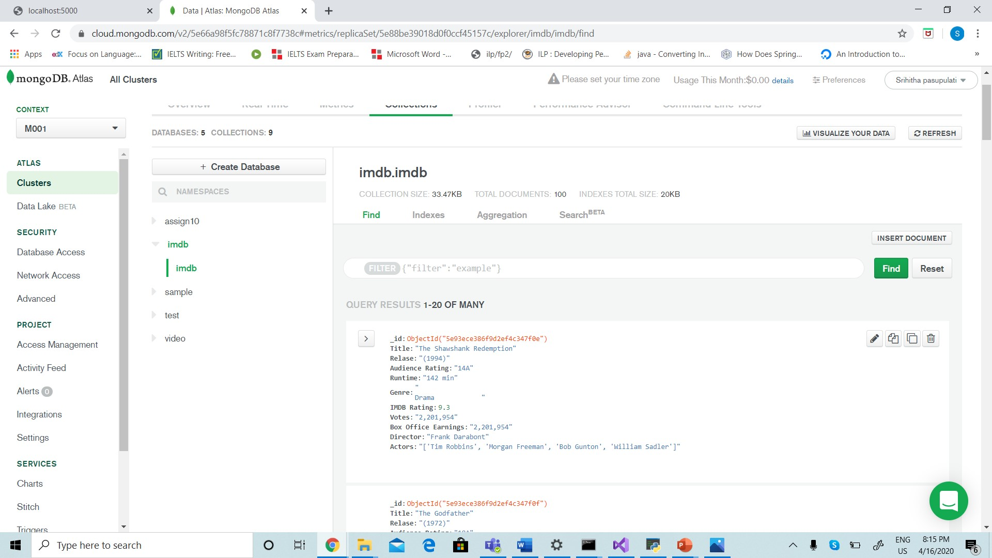
DATA AFTER INSERTING INTO MONGO-DB

Slide 5
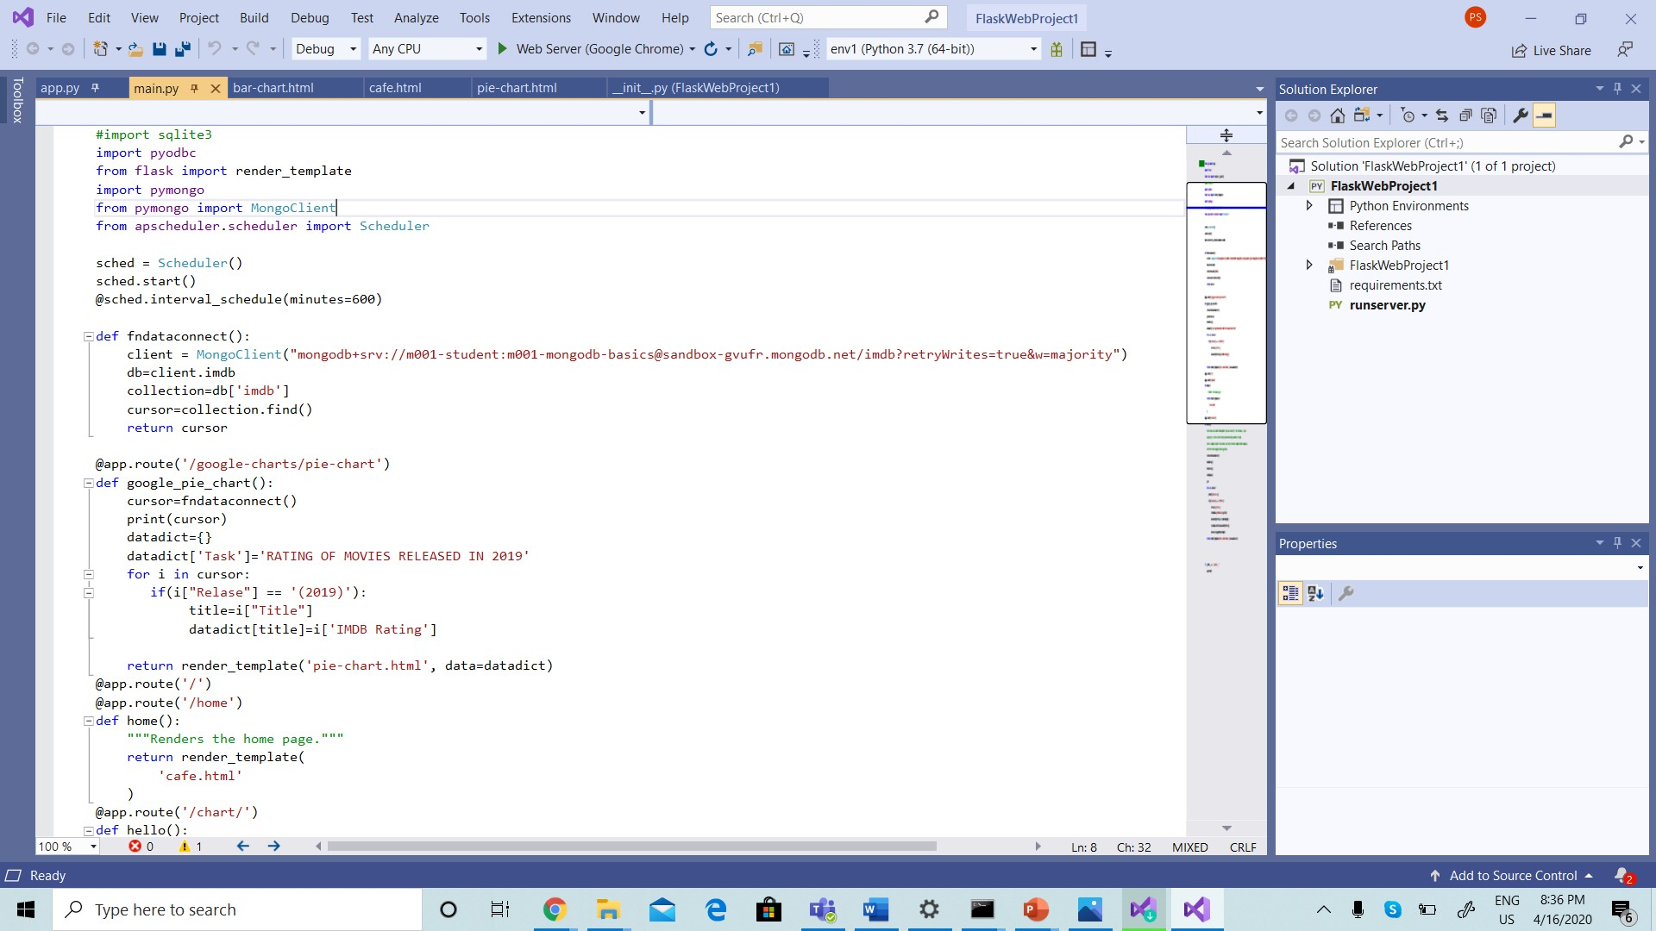
CODE TO EXTRACT DATA FROM CLOUD

Slide 6
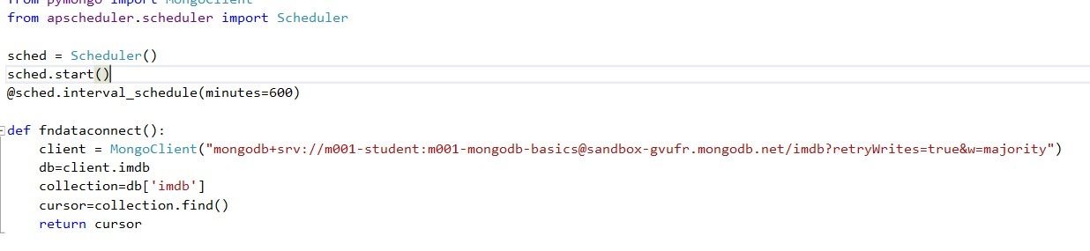
A pseudo-batch process that runs every 24-hours to acquire data and store in this database with the help of APSHEDULER

Slide 7
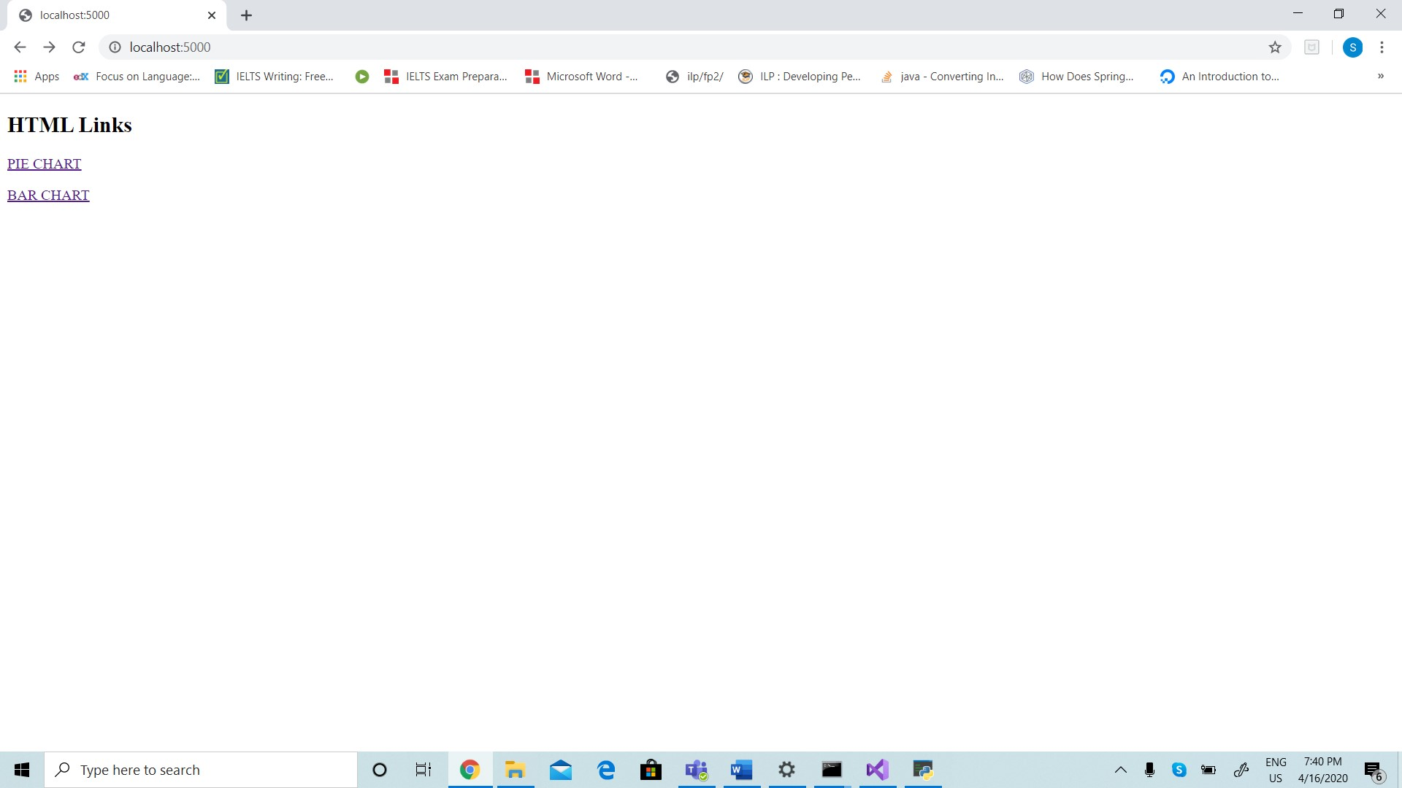

Slide 8
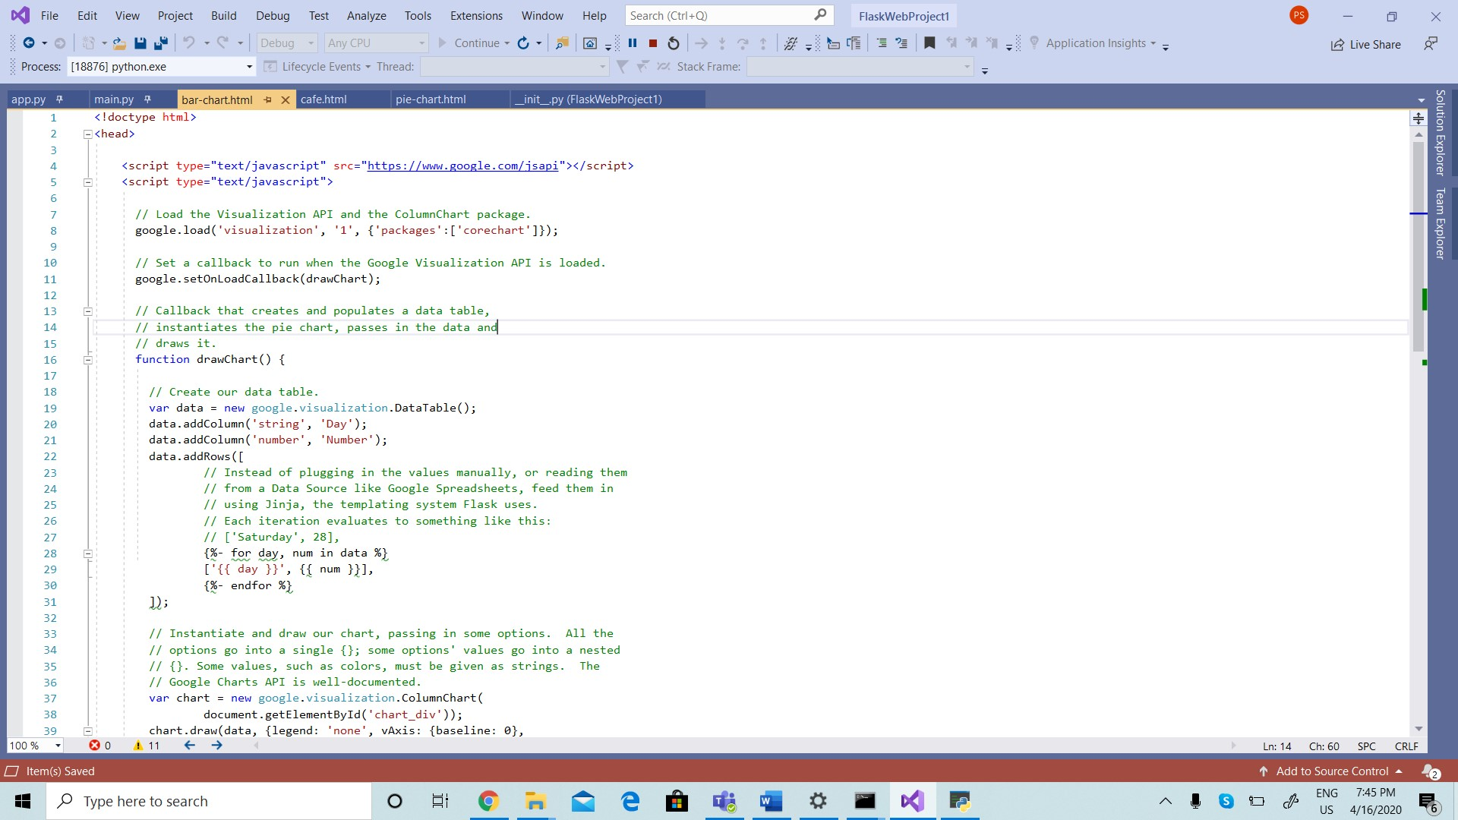

Slide 9
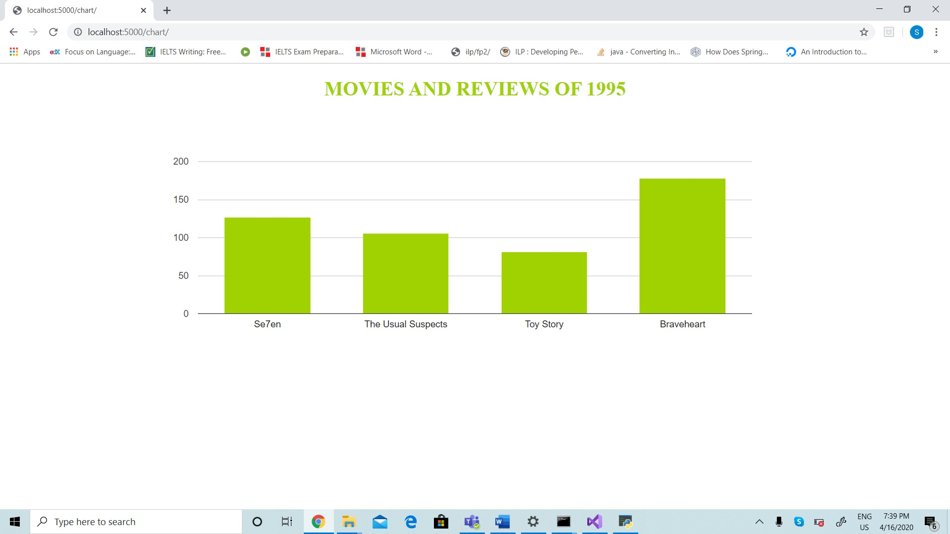

Slide 10
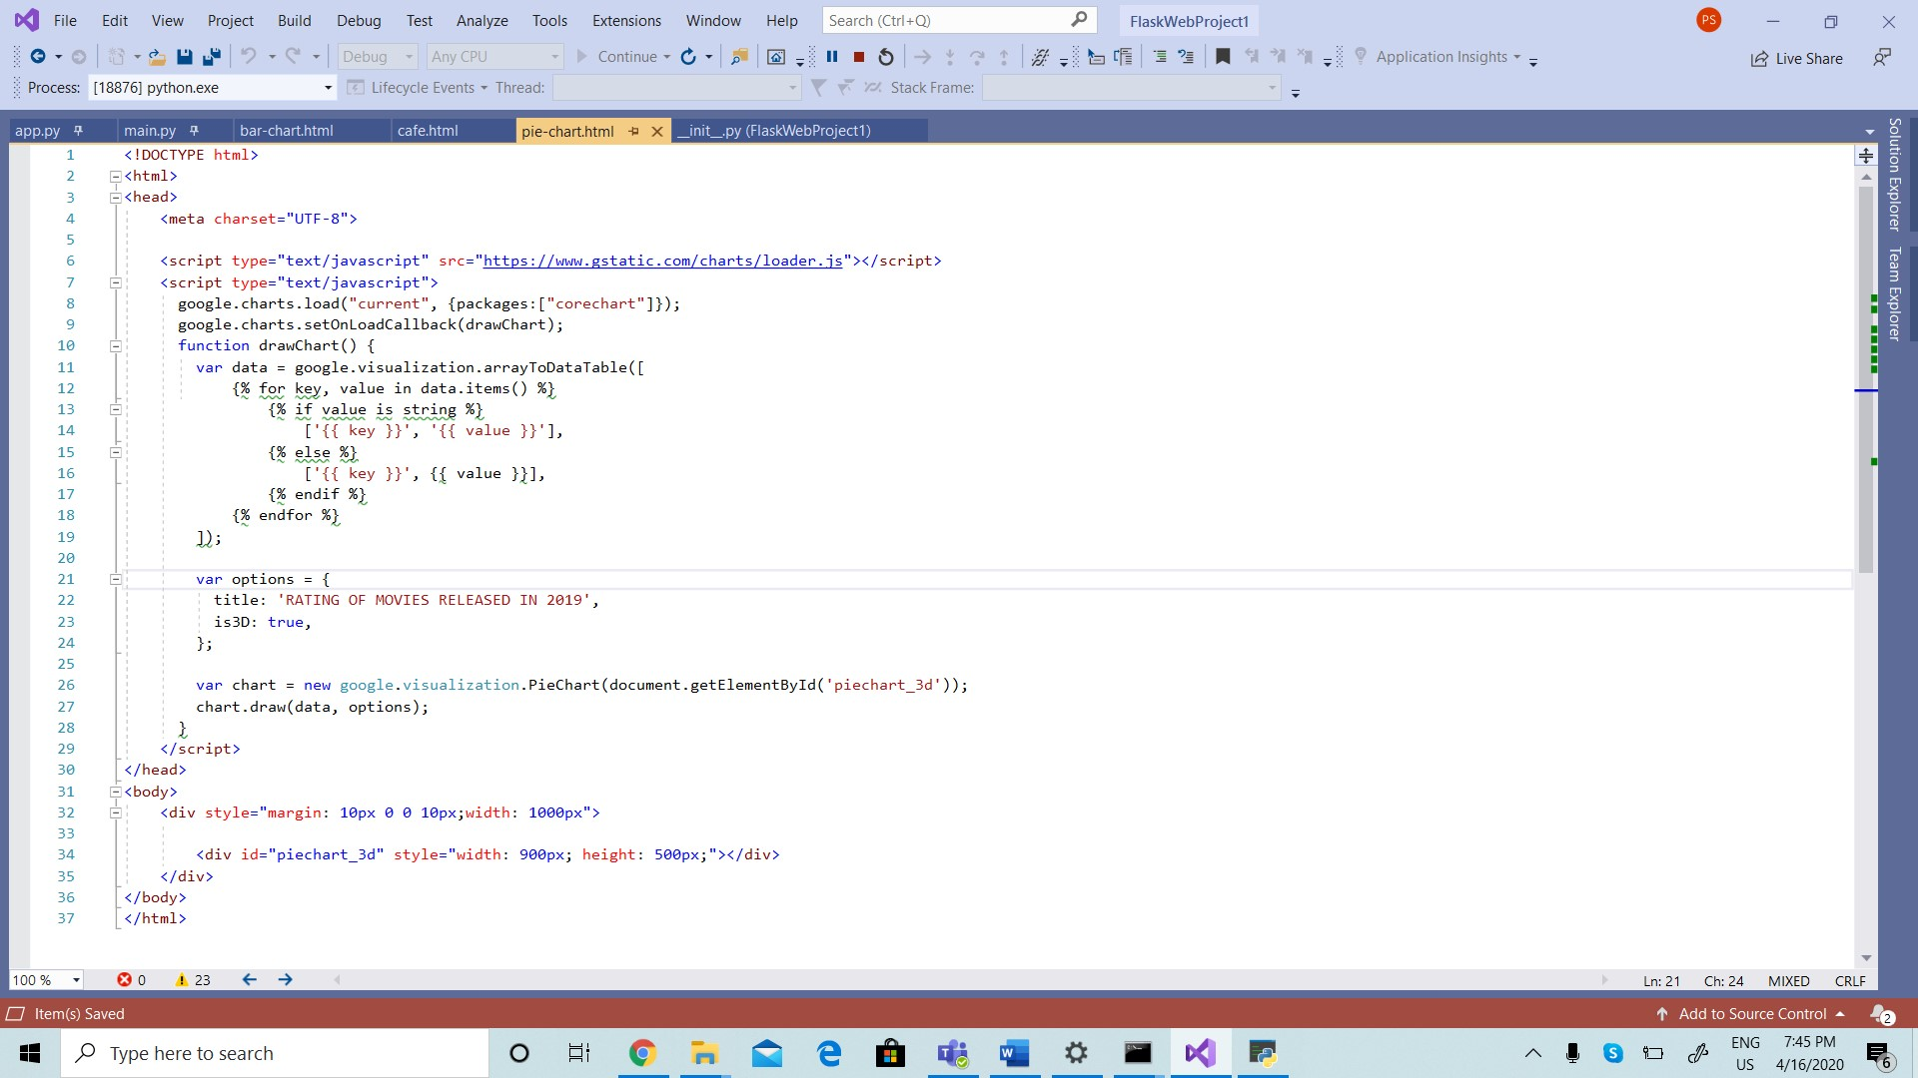

Slide 11
